Slide 1
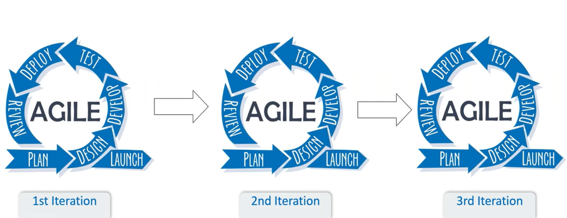
Application of Agile Methodology Using TCS Jile
Presented by- Sakshi Kadam
Prn: 21ST114282009
Roll No.: 13

Slide 2
About Tata Consultancy Services
TCS is one of the largest Indian multinational IT services and consulting companies.
They provide a wide range of services including application development, maintenance, and support to clients across various domains.
Products and platforms: TCS ADD, TCS BFSI, TCS ERP, TCS TAP, TCS Mastercraft, TCS ION, JILE

Slide 3
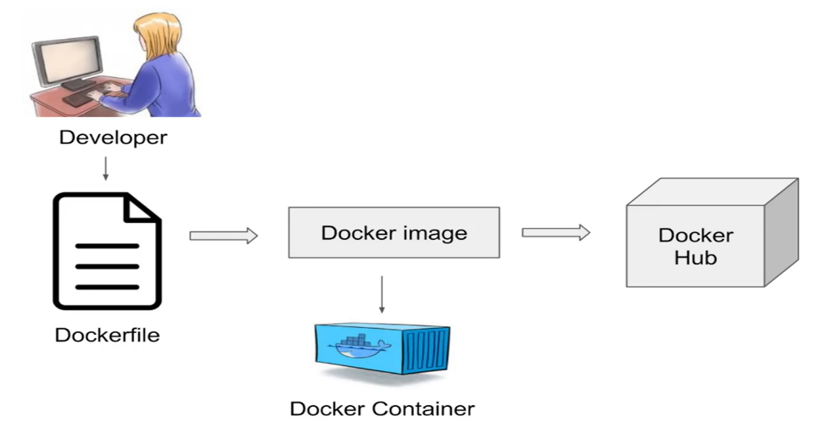
About Internship
Understand Agile Methodologies and TCS Jile product.
Design & develop, the “Simple Employee Information System project” in Agile Method.
Plan & track the project using Jile product.

Slide 4
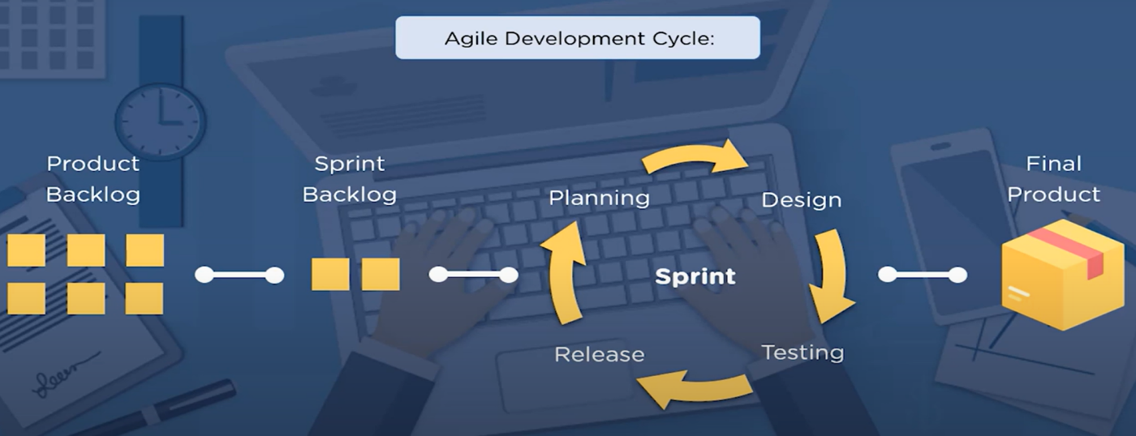
Objective of the Internship
The objective of this project is to learn Agile Methodology through the use of a TCS product called JILE.

Slide 5
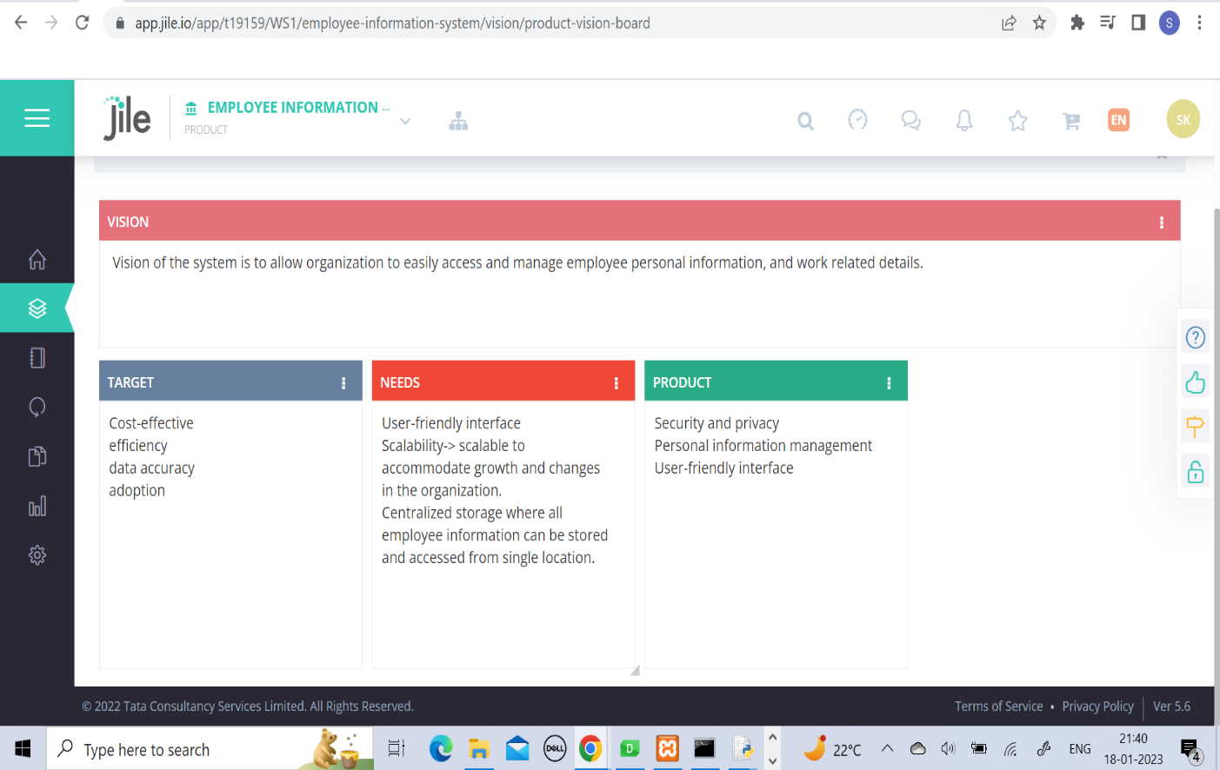
Setting the Vision for the project

Slide 6
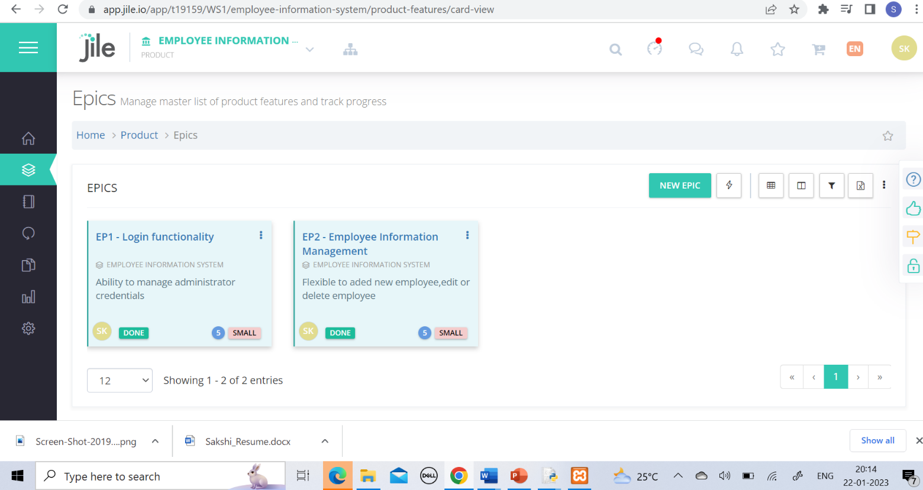
Setting the Epics for the project

Slide 7
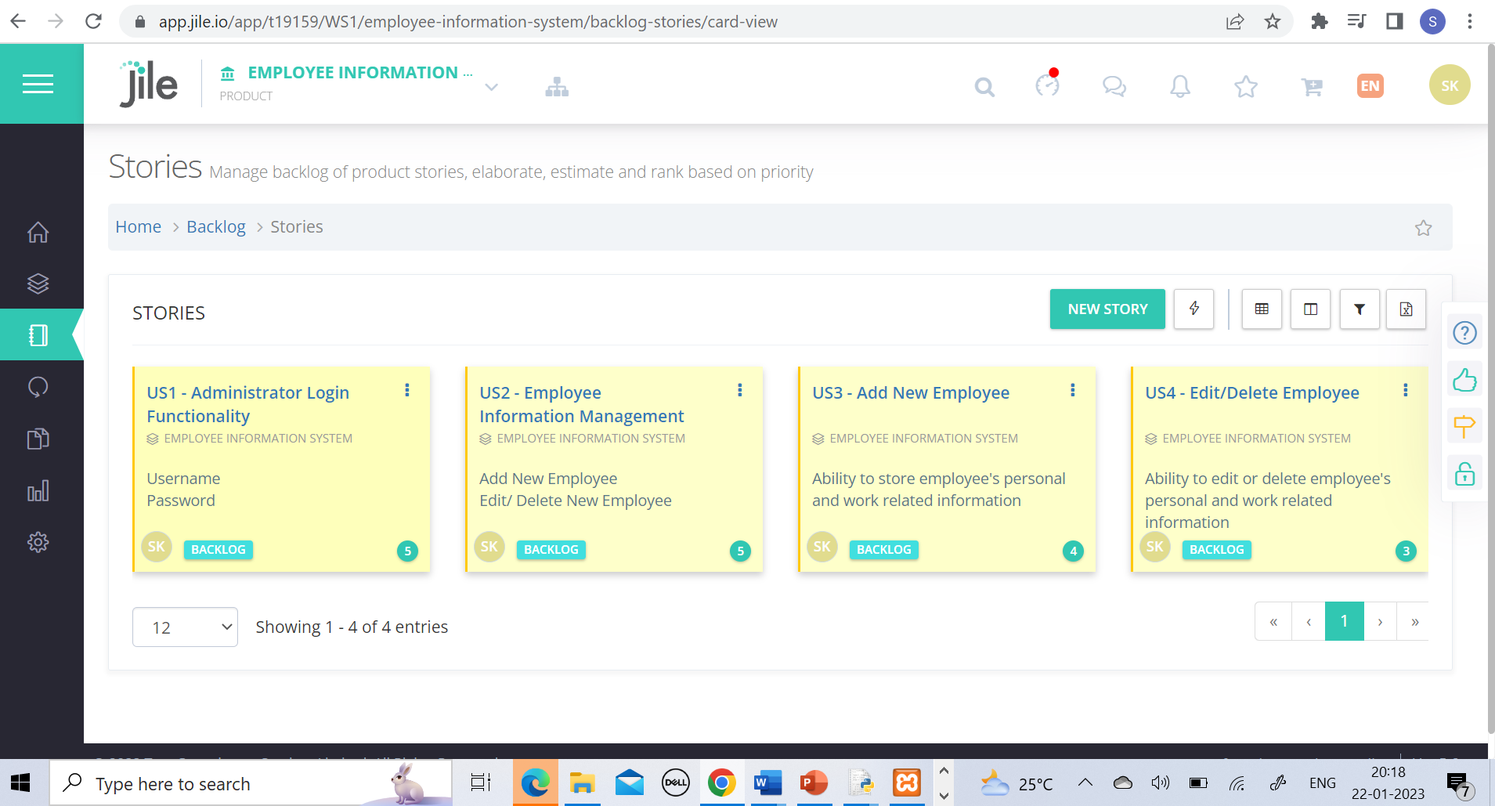
Setting the Stories for the project

Slide 8
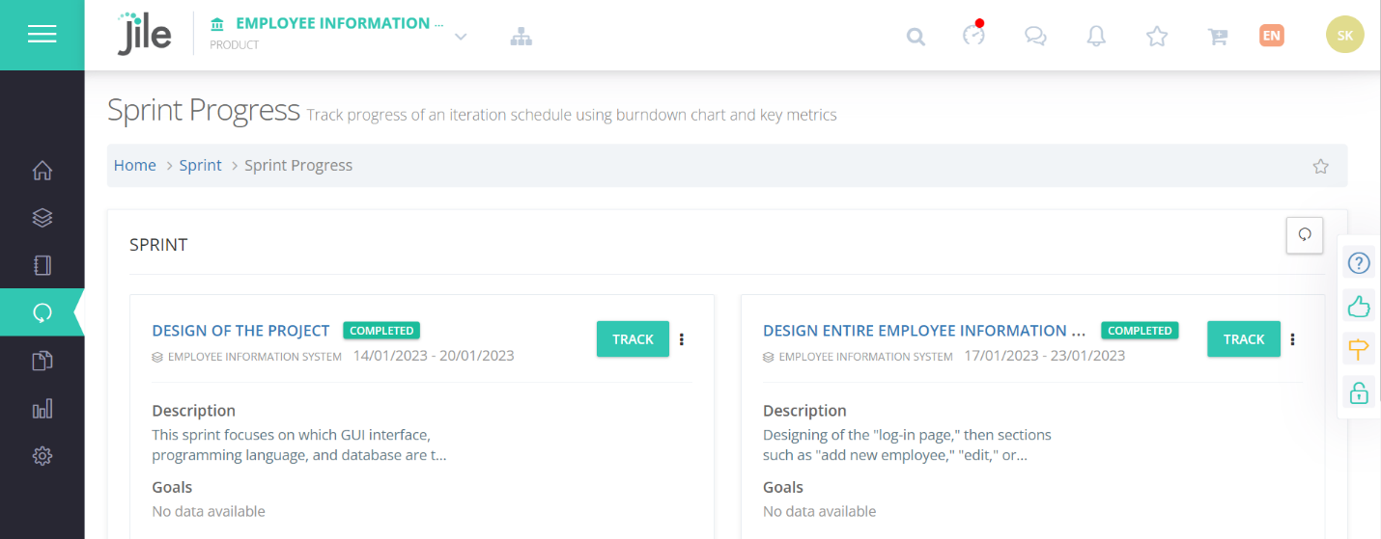
Sprint planning and track progress

Slide 9
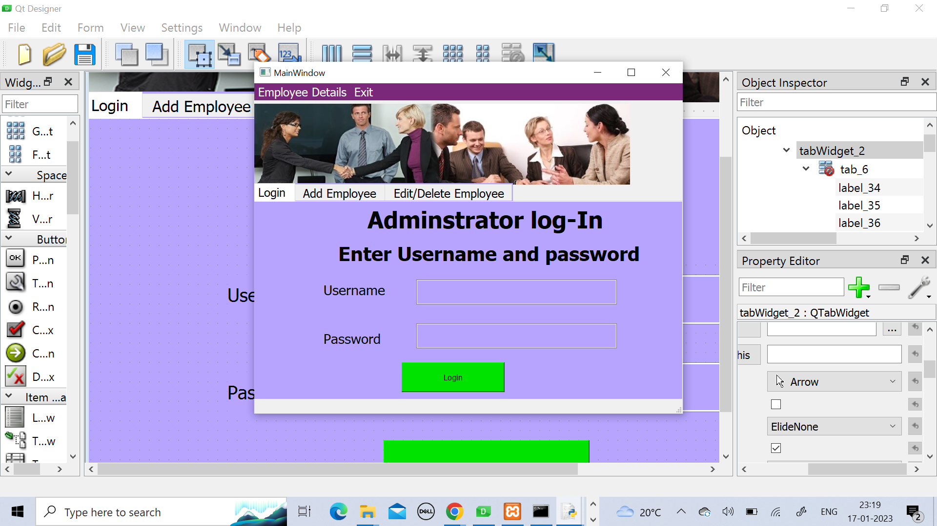
Log-In page Design

Slide 10
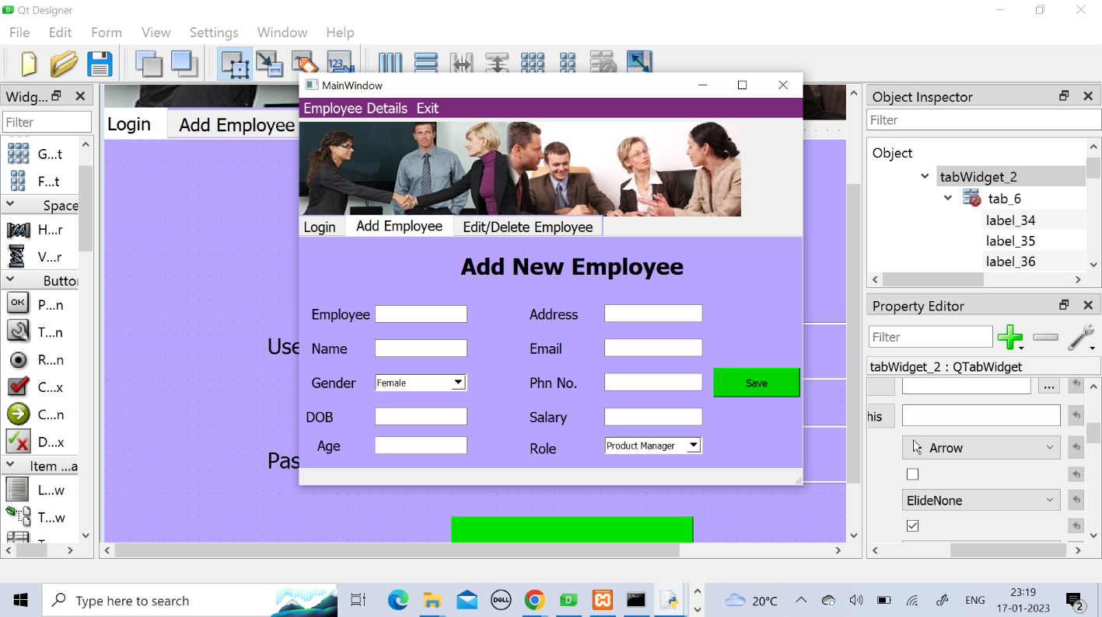
Add New Emp page Design

Slide 11
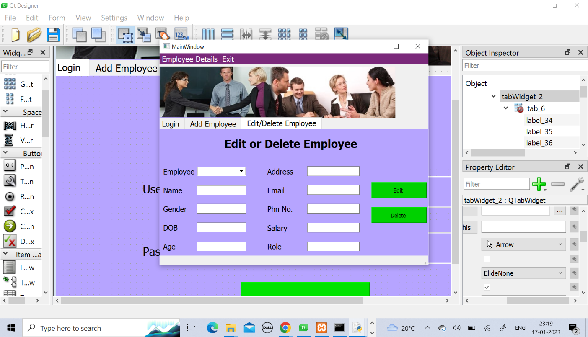
Edit/Delete Emp page Design

Slide 12
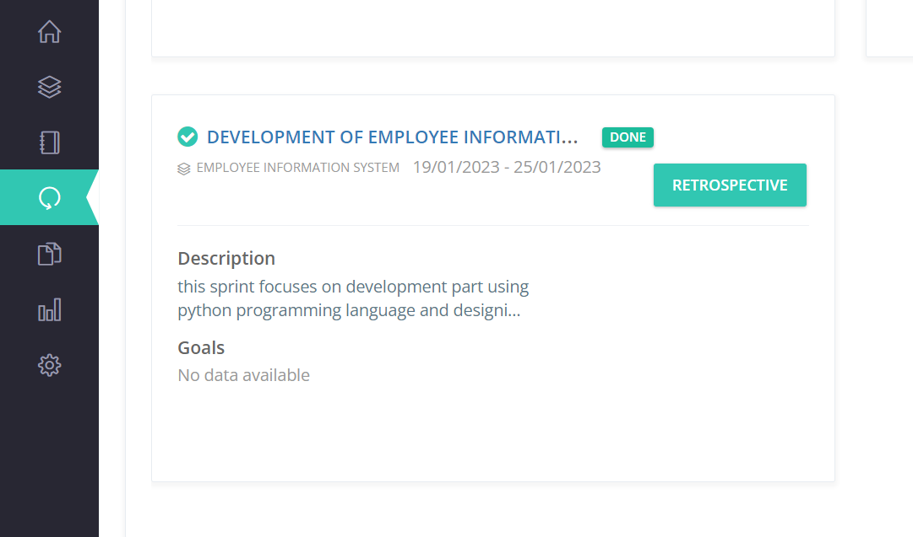
Development of the System

Slide 13
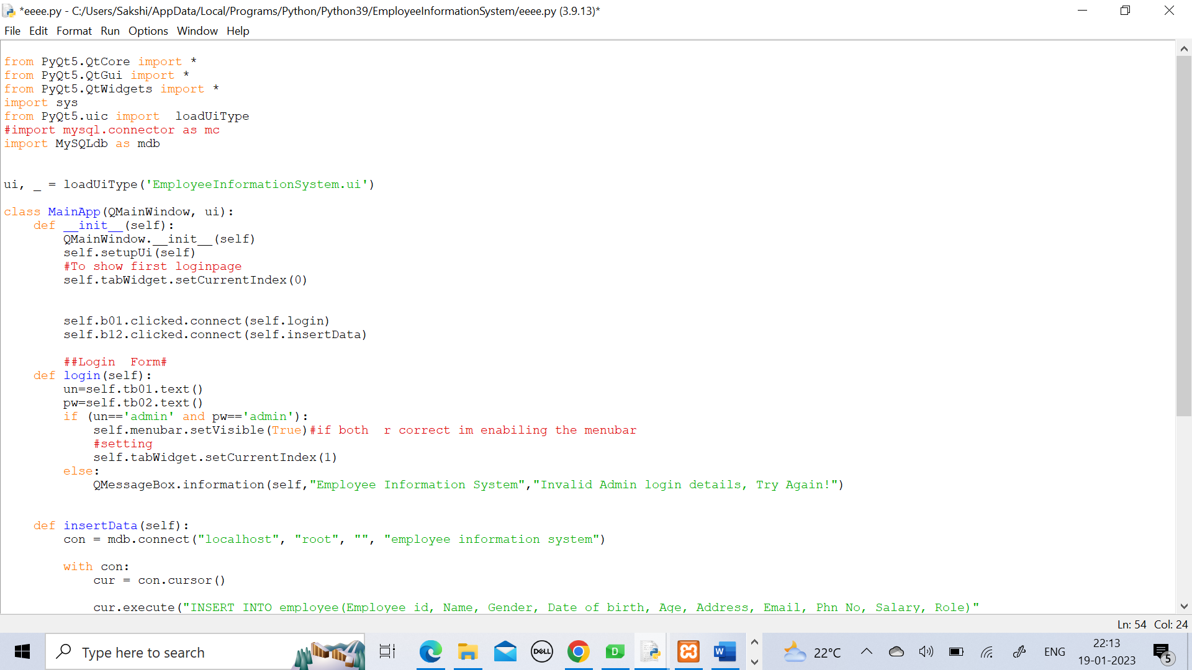
Python code

Slide 14
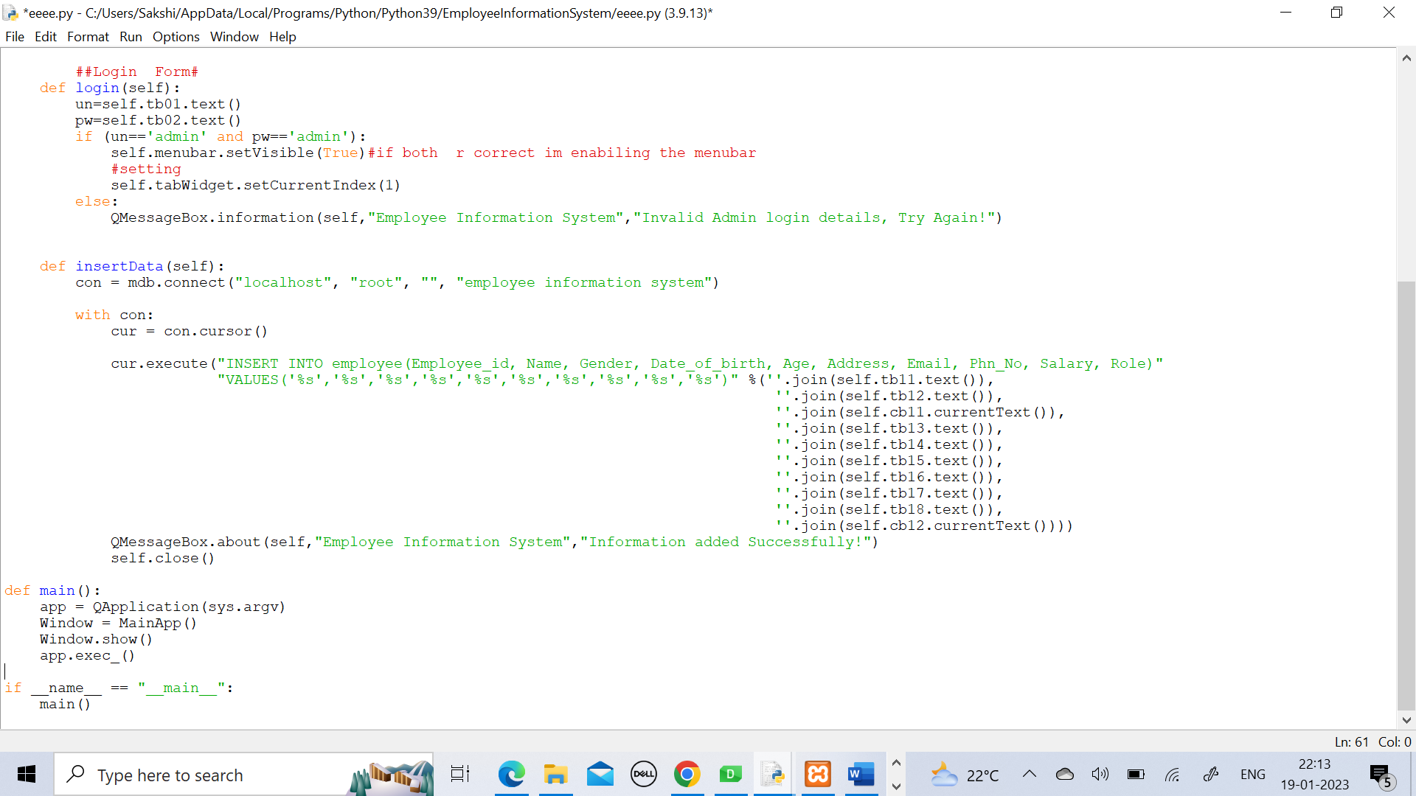
Python code

Slide 15
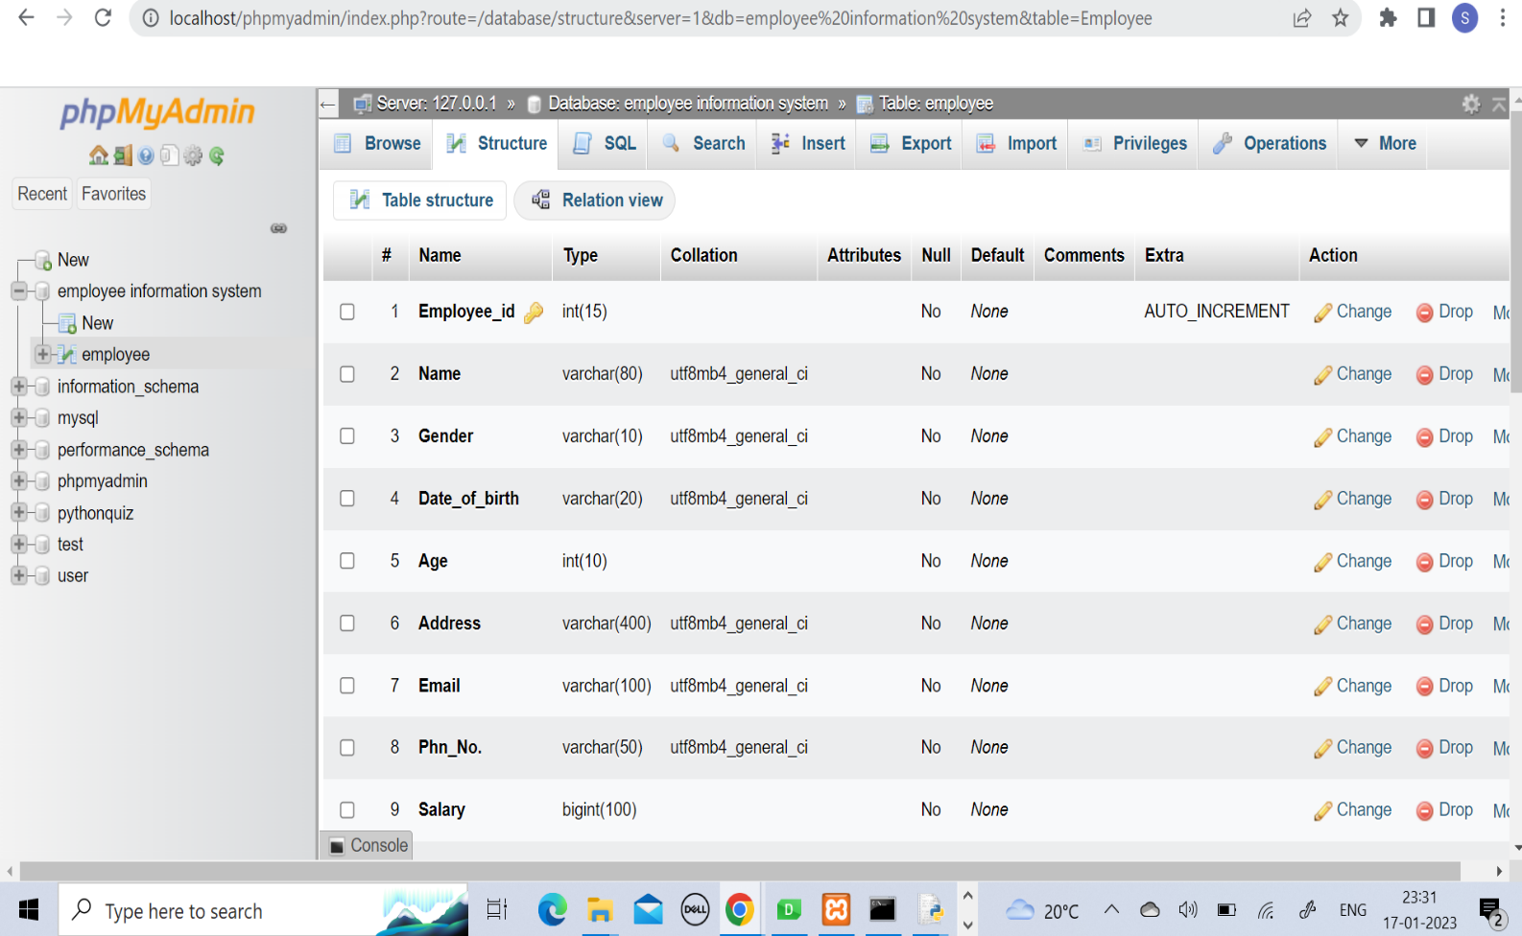
Database Structure

Slide 16
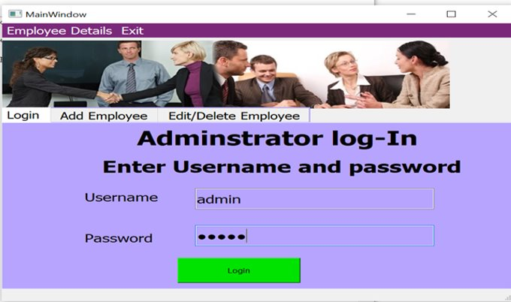
Log-In Page

Slide 17
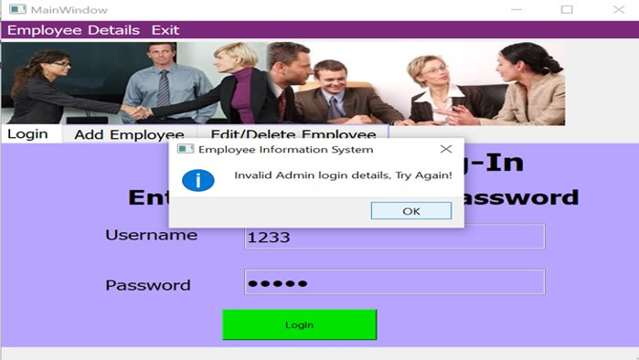
If Username and Password are Incorrect, system will generate one Message Box as Follows

Slide 18
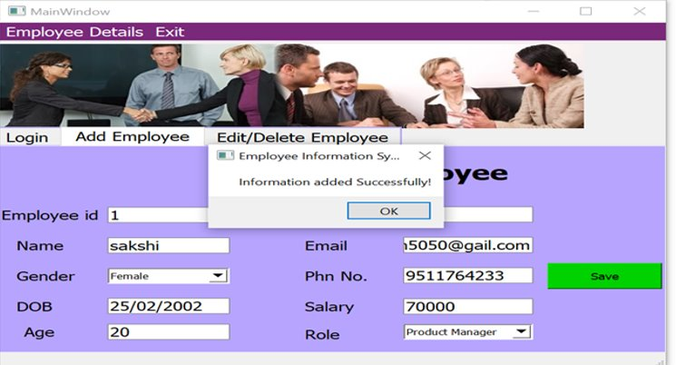
After Adding information Successfully in database, System will generate one Message box as follows

Slide 19
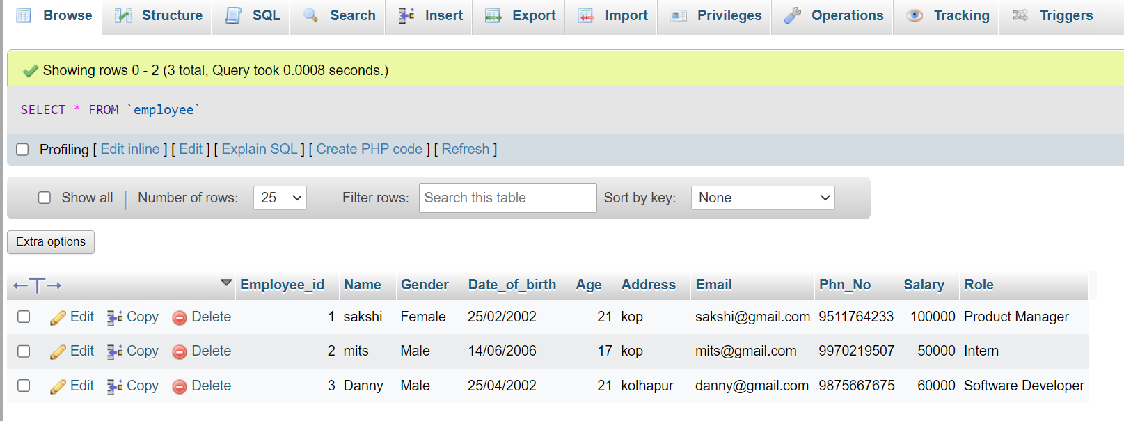
Database After successfully added Emp info

Slide 20


